Slide 1
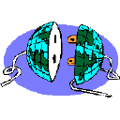
CISC 250 – Business Telecomm Networks
Transmission Media & Structured Cabling Systems

Slide 2
Today’s Outline
Transmission Media
Cable Choices
UTP
STP
Fiber Optic Cable
Structured Cabling Systems
6 subsystems

Slide 3
Cable Choices
UTP (unshielded twisted pair)
STP (shielded twisted pair)
Coaxial (phased out)
Fiber Optic Cable

Slide 4
UTP Wiring
UTP wiring has a number of pairs (usually 2-4) of copper wire
Twisted to reduce EMI
But still have problems
Attenuation
Near-end crosstalk (NEXT)

Slide 5
Electromagnetic Interference (EMI)
Energy from outside the wires. Adds to the signals in the wire.
Shielded wire resists EMI
Unshielded wire is cheaper
EMI
Shielded
Unshielded

Slide 6
Noise and Attenuation
SNR = Signal Power / Noise Power
If SNR is high, noise errors are rare
As signal travels, it attenuates,
and noise errors increase
Power
Signal
Noise Spike
Signal-
to-Noise
Ratio
(SNR)
Noise Floor
(average)
Damage
Noise
Distance

Slide 7
Near-end Crosstalk (NEXT)
Untwisted
at Ends
Signal
Crosstalk Interference
Near-end Crosstalk

Slide 8
UTP Propagation Problems
Two simple things can limit UTP propagation problems
Limit cord distances to 100 meters to control attenuation and noise effects
Limit the untwisting of wires at the connectors to 1.25 cm (0.5 inch) to control terminal crosstalk interference.

Slide 9
UTP Categories
Cat 1: Previously used for POTS telephone communications, ISDN and doorbell wiring.
Cat 2: Previously was frequently used on 4 Mbps token ring networks.
Cat 3: used for data networks using frequencies up to 16 MHz. Historically popular for 10 Mbps Ethernet networks.
Cat 4: Provided performance of up to 20 MHz, and was frequently used on 16 Mbps token ring networks.
Cat 5: Provided performance of up to 100 MHz, and was frequently used on 100 Mbps Ethernet networks. May be unsuitable for 1000BASE- T gigabit ethernet.
Cat 5e: Provides performance of up to 100 MHz, and is frequently used for both 100 Mbps and Gigabit Ethernet networks.
Cat 6: Provides performance of up to 250 MHz, more than double category 5 and 5e.
Cat 6a: Provides performance of up to 500 MHz, double that of category 6. Suitable for 10GBase-T.

Slide 10
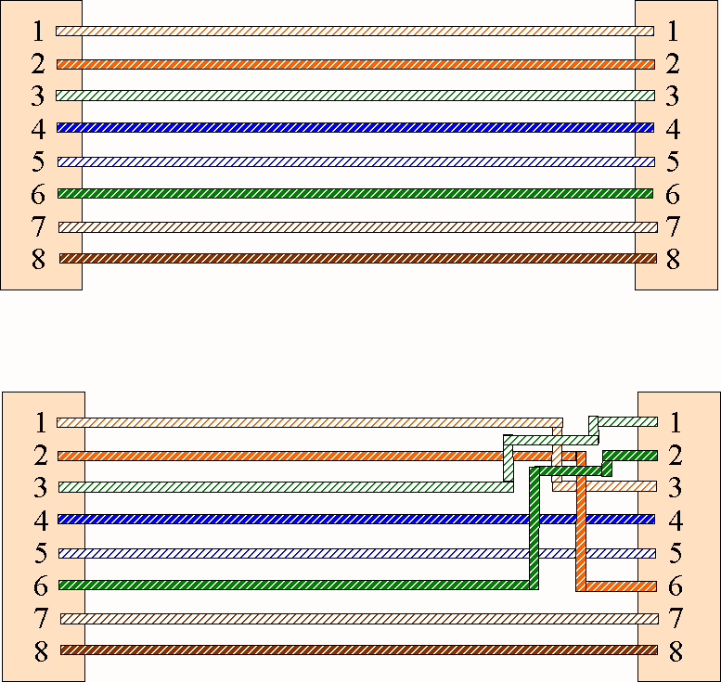
Standard vs. Crossover Cables
Card-to-Hub Wiring
(Standard Cable)
TD+
RD+
TD-
RD-
RD+
TD+
RD-
TD-
Card-to-Card (Hub-to-Hub) Wiring
(Crossover Cable)
TD+ (RD+)
TD+ (RD+)
TD- (RD-)
TD- (RD-)
RD+ (TD+)
RD+ (TD+)
RD- (TD-)
RD- (TD-)

Slide 11
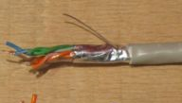
STP Wiring
STP wiring has a number of pairs (usually 2-4) of copper wire that are then shielded with a metal foil.
Shielding provides additional protection against EMI (electromagnetic interference) or RFI (radiofrequency interference).
Disadvantages:
costs more than UTP
less flexible & bulkier than UTP
harder to work with

Slide 12
Fiber Optic Cable
Fiber optic has become the media of choice when looking for high-bandwidth and/or long distance connectivity.
Cladding
Light
Source
(LED or
Laser)
Core
Light
Ray
Reflection at Core/Cladding Boundary

Slide 13
Multimode Fiber
Light only travels in one of several allowed modes
Multimode fiber must keep its distance short or limit modal distortion
Multimode fiber goes a few hundred meters and is inexpensive to lay
Speed: 10 Gb/s
Distance: 550 m (1,800 ft.)
Light Source: LED, VCSEL*
* Vertical Cavity Surface Emitting Laser
It is dominant in LANs
Light
Source
(LED or
Laser)
Core
Mode

Slide 14
Single-Mode Fiber
Single Mode
Cladding
Light
Source
Core
Core is so thin that only one mode can propagate.
No modal dispersion, so can span long distances without distortion.
Speed: +10 Gb/s
Distance: 80+ km (50+ mi.)
Light Source: Laser
Expensive, so rarely used in LANs. Popular in WANs

Slide 15
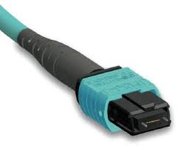
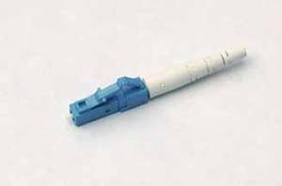
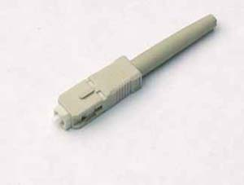
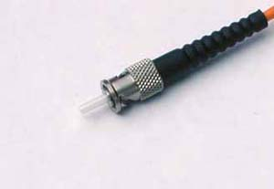
Connectors
Connectors are used to connect fiber to panels or active devices.
LC Connector
MTP Connector
ST Connector
SC Connector
Notes:
There are many different types of connectors in use today.
The fiber technician must be sure to match correctly the equipment with the proper connections. Many devices allow for different types of connections.
The ST uses a bayonet type connection similar in concept but much smaller than the one used by coaxial cable.
Although the ST is still the most widely used because it is relatively easy to terminate, the ST is losing ground to the SC because it requires substantially more room to secure and disconnect.
Device manufacturers are typically looking for high port density (closeness) to keep their manufacturing costs and rack space requirements down.
SC connectors can be used individually or as part of a duplex connector.
Both parts of the SC connector have a key mechanism to help in seating the connection.
Some students remember the difference between ST and SC by thinking that "C" stands for "cube", which is the shape of the connector.

Slide 16
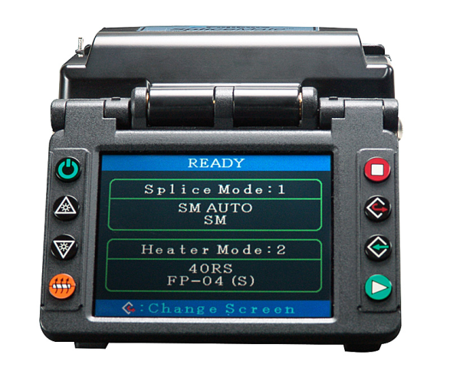
Advantages of Fiber
Secure (almost un-tappable)
Immune to EMI
Low error-rates
High bandwidth, great distance

Slide 17
Structured Cabling
ANSI/EIA/TIA standard: 568A/B/C.
6 sub-systems in telecom wiring in commercial buildings
Entrance Facility
Equipment Room
Backbone Cabling
Telecommunications Closet
Horizontal Cabling
Work Area
Google Data Center
Microsoft Underwater Data Center

Slide 18
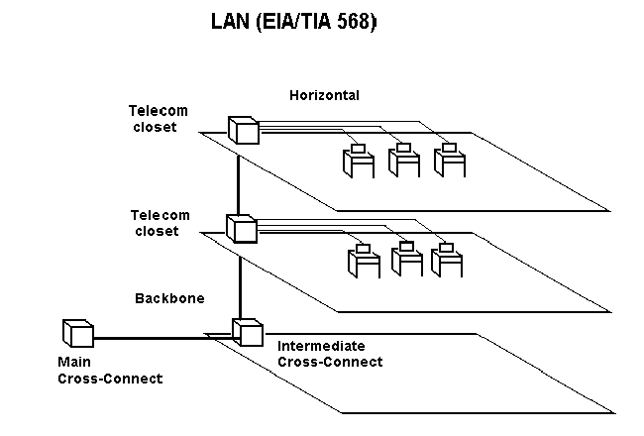
Building Entrance
Equipment Rooms

Slide 19
Work Area
From the information outlet (or telecommunication outlet) to the station equipment
Relatively simple
moves, adds, and changes are easily managed
Work area components:
Station equipment
Patch cables (or station cable), usually ~3m, cannot be > 10 m.
Adapter (baluns, etc., external to information outlet)

Slide 20
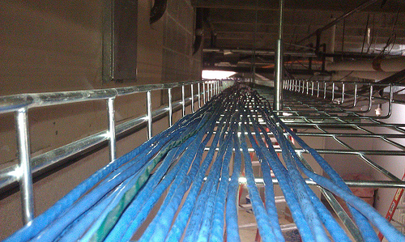
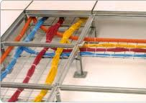
Horizontal Cabling
From the information outlet in the work area to the horizontal cross-connect (HC) in the telecommunication closet (TC)
In star topology
Length limit: 90 m
Overhead
Under floor

Slide 21
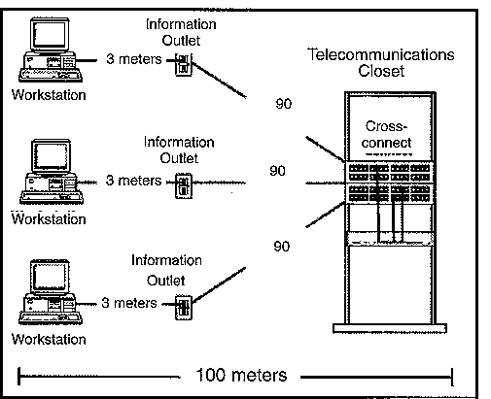

Slide 22
Telecommunications Closet (TC)
It is a closet or cabinet to house:
terminations for the other end horizontal cabling
cross connect device (patch panels)
patch cords (or cross connect cords)
electronic hub equipments for the network of that floor
hub equipments are not defined in SCS
vary according to the type of network to be used – Ethernet, token ring, etc.

Slide 23
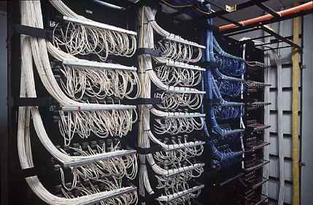
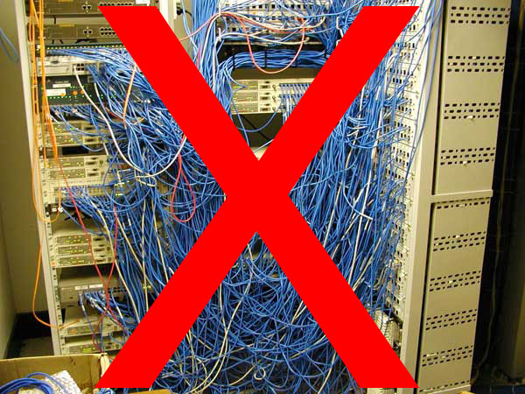
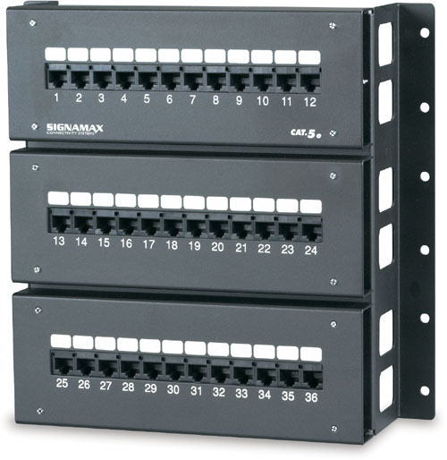
Cross-connect devices in TC

Slide 24
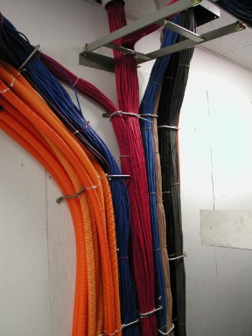
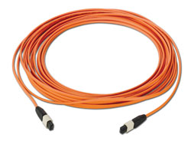
Backbone Cabling
Cabling between TC, equipment rooms, and building entrance facilities, including
vertical connection between floors (risers),
cables between an equipment room and building cable entrance facilities
cables between buildings (inter-building in case of large system)
The most commonly used cabling are multi-mode fibres

Slide 25
Equipment Room
Anything from a broom closet with communication hardware mounted in the wall to giant rooms with raised floors full racks of equipment and cable trays connecting them
Usually house equipment of higher complexity than TC
The design aspects of the equipment room are specified in the EIA/TIA 569 Standard

Slide 26
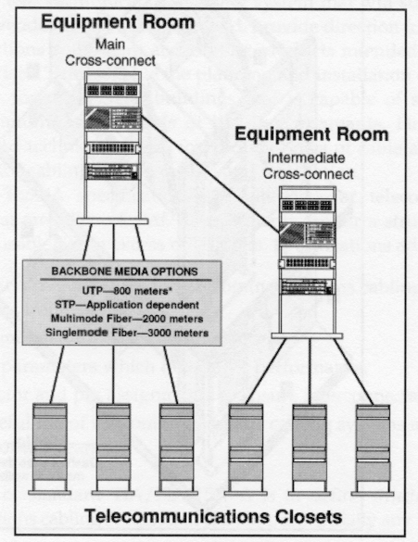
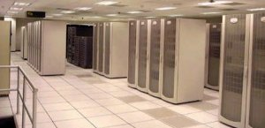


Slide 27
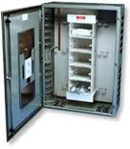
Entrance Facilities
Building entrance facilities provide the point at which outside cabling interfaces with the intrabuilding backbone cabling
The physical requirements of the network interface are defined in the EIA/TIA-569 Standard

Slide 28
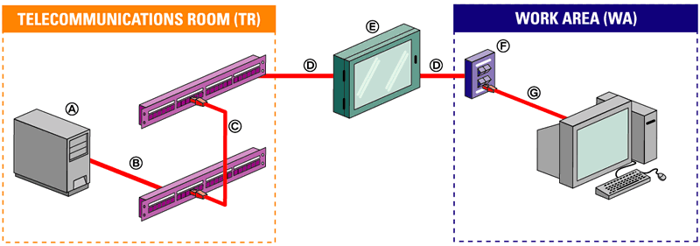
Summary (YouTube Video)
Customer Premises Equipment
Equipment Cord
Patchcords/cross-connect jumpers, including equipment cables/cords, should not exceed 5m (16 ft.).
Horizontal cable 90m (295 ft.) max. total
Transition point of consolidation point(optional)
Telecommunications outlet/connector (TO)
Work Area (WA) Equipment cord

Slide 29
